Slide 1
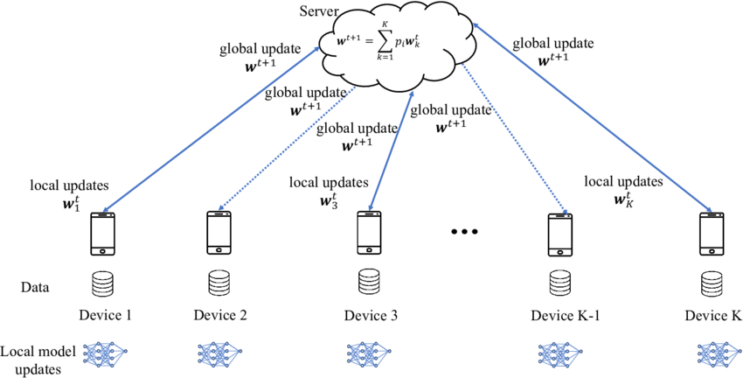
图1 来源于网络，其他的图均为原创

Slide 2
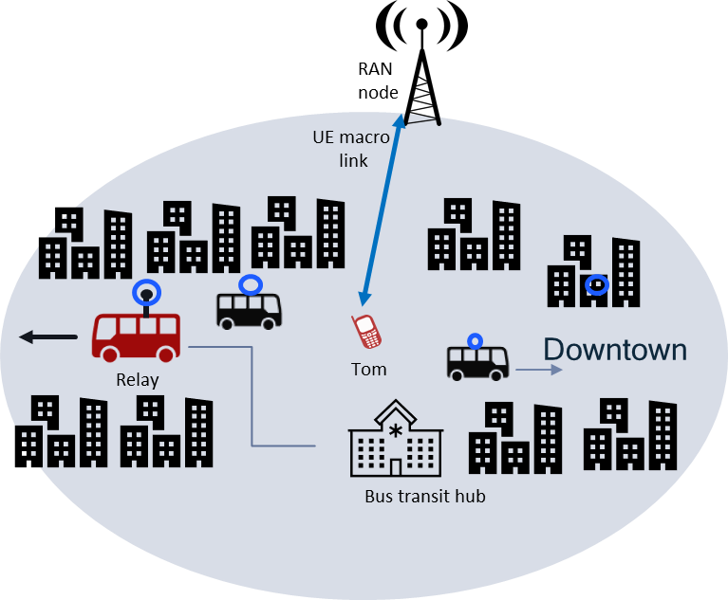
One global aggregation after every k₂ relay aggregations
f) Global model aggregation
h) Global model distribution
One relay aggregation after every k₁ UE iterations
k₁k₂ iterations
e) Relay model uploading
b) Local gradient uploading
c) Local model aggregation
…..
d) Parameter distribution
…..
…..
a) k₁ iterations
图2

Slide 3



k₁k₂ iterations
CUE
VMR#i
VMR#i
VMR#j
Handover
$$×$$
$$×$$
$$×$$
…
图3

Slide 4



VMR#i
VMR#i
VMR#j
Handover
$$×$$
$$×$$
$$×$$
…..
…..
图4

Slide 5



VMR#i
VMR#j
VMR#i
Handover
$$×$$
$$×$$
$$×$$
…..
…..
图5

Slide 6








No handover before $T_{train}$ is over
$$T_{serve}$$
$$t_{1}$$
$$t_{2}$$
$$t_{train}$$
$$T_{1}$$
$$T_{2}$$
$$T_{train}$$
图6

Slide 7
Handover
$$T_{serve}$$
$$t_{1}$$
$$t_{2}$$
$$t_{train}$$
$$T_{1}$$
$$T_{2}$$
$$T_{train}$$
图7

Slide 8


No handover before $t_{train}$ is over
$$T_{serve}$$
$$t_{1}$$
$$t_{2}$$
$$t_{train}$$
$$T_{1}$$
$$T_{2}$$
$$T_{train}$$
图8

Slide 9

Handover
$$T_{serve}$$
$$t_{1}$$
$$t_{2}$$
$$t_{train}$$
$$T_{1}$$
$$T_{2}$$
$$T_{train}$$
图9

Slide 10

$$T_{serve}$$
Handover
$$t_{1}$$
$$t_{2}$$
$$t_{train}$$
$$T_{1}$$
$$T_{2}$$
$$T_{train}$$
图10

Slide 11

No handover before $T_{train}$ is over
$$T_{serve}^{c}$$
$$T_{1}$$
$$T_{2}$$
$$T_{train}$$
图11

Slide 12

Handover
$$T_{serve}^{c}$$
$$T_{1}$$
$$T_{2}$$
$$T_{train}$$
图12

Slide 13

$$T_{serve}^{c}$$
Handover
$$T_{1}$$
$$T_{2}$$
$$T_{train}$$
图13

